Slide 1
Underlay Device-to-Device Communication Lte-A and Cellular Networks
Alireza Khaksri
National Technical University of Athens Mobile Personal Communication – 2018-2019

Slide 2

Outline
INTRODUCTION
Technical perspective of D2D
D2D Standardization Activities and History
Classifications of D2D Communications
D2D Different Types
Advantages and disadvantages of the different types of D2D communications
Critical Technologies for Underlay D2D Communications
Security in D2D

Slide 3
INTRODUCTION
Increasing demand for broadband mobile wireless communications
High growth rate of wireless communication and data traffic
Subscriber base increase exponentially etc.
Device-to-device (D2D) communications
It is a promising technique for offloading local traffic from cellular base stations by allowing local devices, in physical proximity, to communicate directly with each other.
Through relaying, D2D is also a promising approach to enhancing service coverage at cell edges or in black spots.
Open up opportunities for new proximity-based services and applications

Slide 4
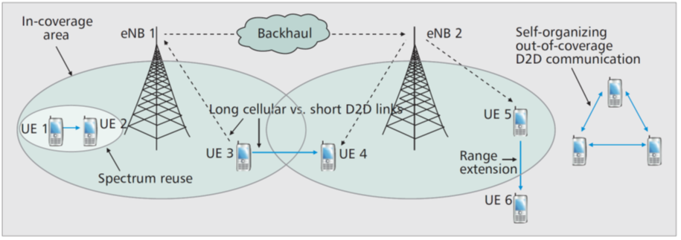
Technical Perspective
Exploiting the natural proximity of communicating devices may provide multiple performance benefits.
D2D user equipment (UE) may enjoy high data rates and low end-to-end delay due to the short-range direct communication.
It is more resource-efficient for proximate UE devices to communicate directly with each other than routing through an evolved Node B (eNB) and possibly the core network. compared to normal downlink/uplink cellular communication, direct communication saves energy and improves radio resource utilization.
Switching from an infrastructure path to a direct path offloads cellular traffic, alleviating congestion, and thus benefitting other non-D2D UE as well.
Illustration of possible D2D use cases and potential benefits[5]

Slide 5
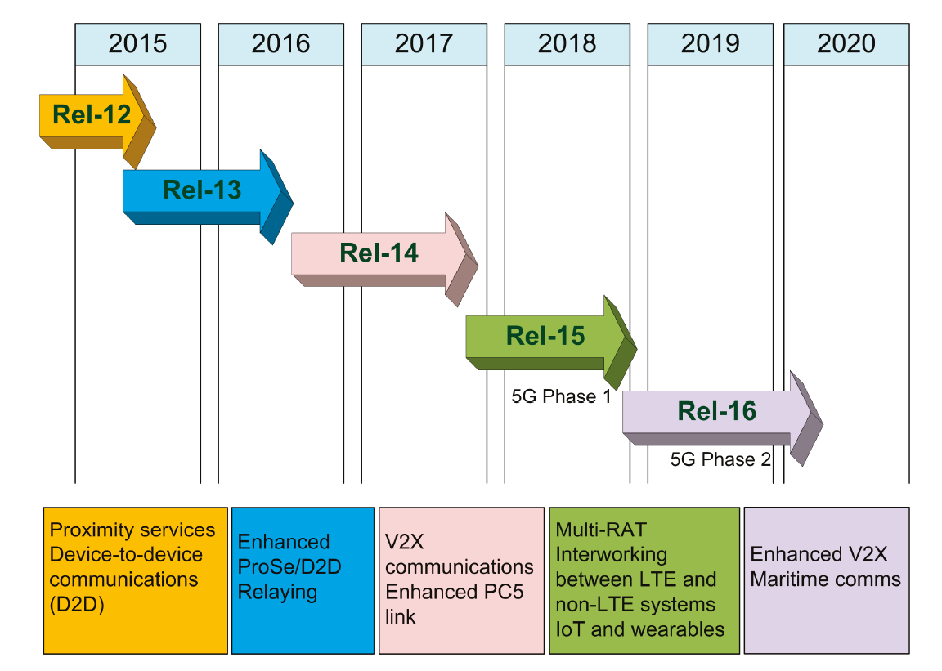
Standardization-History
In earlier studies D2D was mainly proposed for relaying purposes.
D2D in cellular networks has been motivated by the trend of proximity-based services and public safety needs.
Increasingly network operators and device manufacturer agreed on D2D communications as the future of 5G.
At the 3GPP meeting held in June 2011, the concept of D2D discovery and communication was submitted by Qualcomm (FlashLinQ).
Towards the finalization of LTE Release-11, 3GPP initiated the agenda for Release-12, which was initiated at a workshop in June 2012.
Subsequently, the radio access network (RAN) 58th plenary meeting held in December 2012 agreed to start the study of LTE D2D proximity service (ProSe).
Recent Advances on Cellular D2D Communications
by Boon-Chong Seet, Syed Faraz Hasan and Peter Han-Joo Chong
Future Internet 2018, 10(1), 10; https://doi.org/10.3390/fi10010010

Slide 6
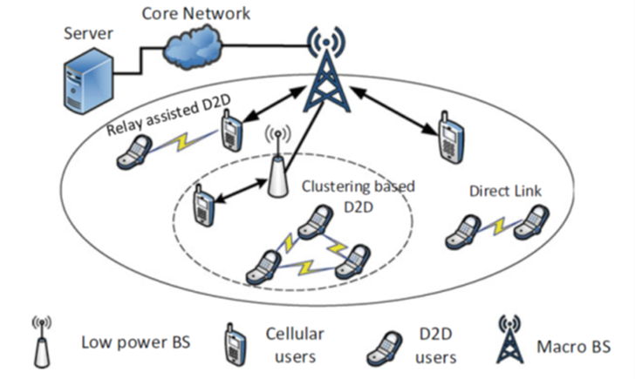
Classifications of D2D Communications
D2D users can communicate with each other in three manners:
D2D Direct Link: The simplest case of D2D communication occurs when transmitters and receivers exchange data directly with each other without intermediate nodes.
Relay Assisted D2D Communications: Given a scenario where a mobile device wants to connect to another node which is out of its communication coverage or is in a poor channel state with the destination node, cellular users may be employed as relays to improve the data transmission between transmitters and receivers.
Clustering-Based Communications: In a content sharing or information diffusion scenario, users requesting the same file in a short range can potentially form a cluster to allow the desired file to be multicasted within the cluster to save both bandwidth and time delay.
Different use cases of D2D communications [9]

Slide 7
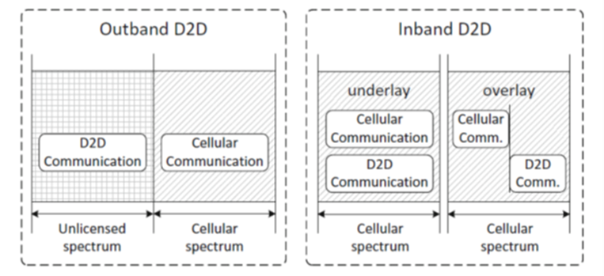
D2D Different Types
Both unlicensed and licensed spectrum resources can be occupied by D2D users for communication [9], based on which D2D communications divided into outband D2D communications and inband D2D communications.
Outband D2D[9]:
In this category, D2D communication is performed in the unlicensed spectrum such as ISM 2.4G which made the interference between D2D and cellular communications impossible.
Outband D2D may suffer from the uncontrolled nature of unlicensed spectrum.
To exploit the unlicensed spectrum, it is necessary to have another extra interface that implements WIFI Direct, Zig Bee or Bluetooth.
Autonomous outband D2D communications: the cellular network controls all the communications but leaves D2D communication to the users themselves (extra interface/technology).
Controlled outband D2D communications: coordinations between radio interfaces is controlled by cellular network.
Outband D2D: D2D communications under this category exploit unlicensed[9]

Slide 8
D2D Different Types
Both unlicensed and licensed spectrum resources can be occupied by D2D users for communication [9], based on which D2D communications divided into outband D2D communications and inband D2D communications.
Inband D2D[9]:
In this category, D2D communications operate on licensed spectrum (i.e., cellular spectrum) which is also allocated to cellular links.
Motivation for choosing inband is usually high control over cellular (i.e., licensed) spectrum as uncontrollable interference in unlicensed spectrum which add constraints for QoS provisioning.
Underlay D2D communications: DUEs share the same spectrum resources with some other cellular user equipment CUEs (improve spectrum efficiency and network throughput).
Overlay D2D Communications: accommodates direct connection between the transmitter and the receiver.
Iutband D2D: D2D communications under Licenced Spectrum[9]

Slide 9
Advantages and disadvantages of the different types of D2D communications
Advantages of Inband D2D
Underlay D2D increases the spectral efficiency of cellular spectrum by exploiting the spatial diversity. QoS management is easy by reason of entirely controlled by eNBs. The possibility of using Inband D2D communication on any mobile equipment.
Disadvantages of Inband D2D
Challenging control of level of interference. No possibility for D2D and cellular simultaneous transmission. High complication of resource allocation procedure and power control
Advantages of Outband D2D
Easier resource allocation. Possibility of simultaneous occurrence of D2D and cellular users. None interference between D2D and cellular subscribers. None necessary to devote cellular resources to D2D spectrum
Disadvantages of Outband D2D
Necessary to decode and to encode packets. D2D communication only used by LTE and WiFi radio interfaces. Need of the efficient power management.

Slide 10
Critical Technologies for Underlay D2D Communications
Proximity Discovery
Procedure of Proximity Discovery
Mode Selection
3.1 Taxonomy of Typical Communication Modes
4. Resource Management -Interference Management
4.1 power control
4.2 Interference control
4.3 Joint Power Control and Radio Resource allocation Techniques
4.4 Spectrum Splitting Techniques
4.5 Other Interference Mitigation Techniques
4.6 Multiple-Input Multiple-Output Techniques
4.7 Comparative analysis of D2D Interference Mitigation Techniques

Slide 11
Critical Technologies for Underlay D2D Communications
Proximity Discovery
Proximity discovery or D2D discovery, users can discover other users that are in the proximity.
Using E-UTRA, this process identifies that a UE is in proximity of another [1].
The D2D discovery can be initiated either before the DUEs start to communicate (labeled as “priori”) or during ongoing communication (known as “posteriori”) [11].
In priori, a user initiates the discovery process by broadcasting beacon signals at regular intervals, prior to the actual communication session between the users.
In posteriori, a discovery process is initiated by the eNB, while a communication session is ongoing between users.
In both cases, the eNB reserves a discovery resource pool, which is utilized for D2D discovery purposes [12].
FlashLinQ takes advantage of OFDM/OFDMA technologies and distributed scheduling to create an efficient method for timing synchronization, peer discovery, and link management in D2D-enabled cellular networks.
3GPP is also investigating D2D communications as Proximity Services (ProSe) [10].

Slide 12
Critical Technologies for Underlay D2D Communications
2. Procedure of Proximity Discovery
Distributed Approaches: In this category, UEs broadcast their identities periodically so that other UEs may be aware of their existence and decide whether to start D2D communications or not[9].
Network-Assisted Approaches: In network-assisted proximity discovery, pairable D2D UEs detect and identify each other with the assistance of the network (centralized or semi-centralized).
Step 1: UE 1 informs the BS about its intention to communicate with UE 2;
Step 2: BS requests UE 2 to expect a discovery message from UE 1, and UE 1 is informed to send the discovery message;
Step 3: UE 1 sends discovery message to UE 2;
Step 4: UE 2 reports the measured signal-to-interference-plus-noise ratio (SINR) value of the message transmitted by UE 1 to the BS;
Step 5: BS requires both UE 1 and UE 2 to listen for interference from existing users in the cell;
Step 6: UE 1 and UE 2 report to the BS their measured results of interference;
Step 7: BS instructs UE 1 and UE 2 to communicate with each other via D2D link if the direct link between UE 1 and UE 2 is favorable.
Step 1: UE 1 sends discovery message to UE 2 without requesting permission from the BS. Both UE 1 and UE 2 listen for interference from the other users in the cell and estimate their path gains to the BS immediately upon the reception of the message sent by UE 1 to UE 2;
Step 2: UE 2 reports its measured results to UE 1 in terms of the interference it suffered and its path gains to the BS;
Step 3: UE 1 feeds back to the BS about the SINR and interference measurements for both UE 1 and UE 2;
Step 4: BS requests both UEs to initiate D2D communications.
Semi-centralized proximity discovery procedure
Centralized proximity discovery procedure

Slide 13
Critical Technologies for Underlay D2D Communications
3. Mode Selection
D2D communications have the potential to achieve performance gain over traditional cellular communications in terms of bandwidth, time delay and power.
More sophisticated objectives like optimal spectrum reuse, weighted sum-rate maximization, etc. could also be used [2].
Generally mode selection can be categorized in Static and Dynamic .
Overview of mode selection techniques for D2D communication [13]

Slide 14
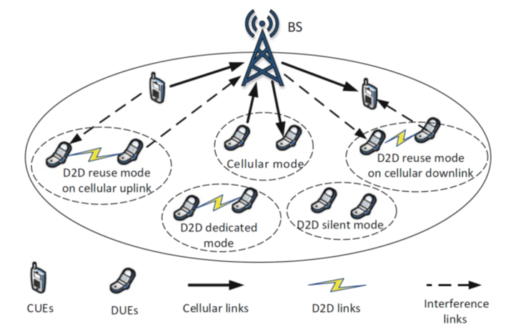
Critical Technologies for Underlay D2D Communications
3. Mode Selection: Taxonomy of Typical Communication Modes
D2D Silent Mode: When available resources are not enough for D2D communications with dedicated resources, and spectrum reuse is impossible either owing to harmful interference, D2D users are incapable of data transmission and have to keep silent [9].
D2D Reuse Mode: UEs communicate directly via D2D links by sharing the uplink or downlink spectrum resources of CUEs in cellular D2D underlay [9].
D2D Dedicated Mode: Dedicated cellular spectrum resources are allocated for UEs to communicate directly via D2D links [9].
Cellular Mode: In this mode, two UEs can communicate with each other through the BS without co-channel spectrum sharing in traditional way [9].
Overview of mode selection techniques for D2D communication [13]

Slide 15
Critical Technologies for Underlay D2D Communications
4. Resource Management -Interference Management (RM-IM)
During mode selection, resource management is usually implemented simultaneously to evaluate achievable performance when working on different modes.
Regarded as one of the most critical issues in wireless networks.
Can be carried out to facilitate interference mitigation, energy conservation, and throughput maximization, among others [9].
Generally, resource management in network-assisted D2D communications mainly consists of two parts: spectrum allocation and power control [9].

Slide 16
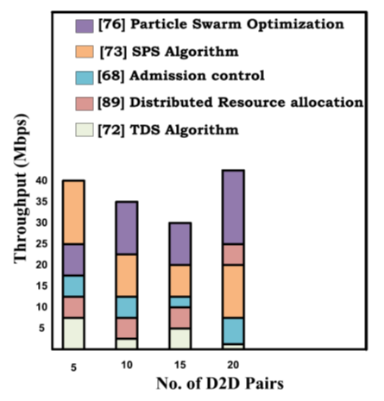
Critical Technologies for Underlay D2D Communications
4.1 (RM-IM) Spectrum Allocation:
By exploiting the spatial diversity, underlaying inband D2D is able to increase the cellular spectrum efficiency.
This can be done by proper interference management, mode selection, resource allocation and by using network coding [10].
In 3GPP LTE specifications, UEs are allocated with certain number of subcarriers for a predetermined amount of time duration, which are defined as physical resource blocks or PRBs.
The allocation of cellular resources to the D2D communications is critical since the interference to other CUEs and DUEs should be kept below a certain level to guarantee QoS requirements.
Main techniques used in literature for improving spectrum efficiency [10]:
Interference reduction among cellular and D2D users
Interference aware/avoidance
Self-organized methods
Non-linear programming and game theory based on heuristics
Comparison of Throughput of Different resource allocation algorithms [13].

Slide 17
Critical Technologies for Underlay D2D Communications
4.2 (RM-IM) power control:
Controlling power of UEs is essential for efficient resource utilization.
Blindly applying D2D communication to cellular networks can result in degradation of system performance [13].
Basically, transmit power of involved users should be controlled to guarantee QoS requirements (e.g., SINR requirements) of different users in the network [9].
Algorithm | Objective
Game theory-based power control scheme | Improvement in the D2D transmission quality
Joint Power and Rate control for D2D communication in cellular networks | Coexistence of both cellular and D2D userscontributing towards improving system throughput
Centralized and distributed power control algorithms using stochastic geometry | Improved throughput performance of cellular users achieved
Distributed Power Control Scheme | Minimize the overall power consumption of the network
Joint resource allocation and power control technique | Maximizing energy efficiency of the network
Binary Power Control Scheme | Improve spectral efficiency and power efficiency
Distance based mobile association Scheme | Better tradeoff achieved between energy efficiency and complexity, in comparison to other techniques
Revised Graph coloring based pilot allocation | Considerable reduction in pilot overhead
Power control algorithms in D2D communication which reviewed in [13] are listed in table

Slide 18
Critical Technologies for Underlay D2D Communications
4.3 (RM-IM) Interference control:
In D2D communication in cellular networks resources are shared by D2D users the cellular users and their neighbors.
When the cellular downlink resources are shared by the D2D users, the cellular users and their neighbors suffer interference.
The receiver of the D2D pair is also susceptible to counter interference by the base station.
When sharing cellular uplink resources, the base station suffers interference by the D2D users [13].
Interference mitigation is possible through proper mode selection, optimum resource allocation and power control of the devices.
The various approaches for interference mitigation are categorized into three types [13]:
Interference Cancellation Techniques: which use advanced coding and decoding methods for cancellation of interference signals at the CUE or DUE. Interference cancellation techniques have the ability to enhance the capacity of cellular networks.
Interference Avoidance Techniques: which avoid interference between cellular links and D2D links by using orthogonal time frequency resource allocation techniques.
Interference Coordination Techniques: which mitigate interference between D2D and cellular links with power control schemes and proper scheduling.

Slide 19
Critical Technologies for Underlay D2D Communications
4.4 (RM-IM) Joint Power Control and Radio Resource allocation Techniques:
A more advanced approach is to jointly use power control with various resource allocation techniques in order to realize the full potentials of D2D communication [12].
Interference management and control between cellular links and D2D links, with the aim of complementing and enhancing the overall performance of a single scheme [12].
Power control and distance–based resource allocation mechanism to mitigate the interference among cellular and D2D users sharing UL resources [12].
A power control and distance–based interference mitigation algorithms [12].
4.5 (RM-IM) Joint Power Control and Radio Resource allocation Techniques:
Spectrum splitting is the easiest way to avoid interference in D2D enabled cellular network. Adopting time division multiplexing (TDM) technology to separate cellular and D2D transmissions could effectively reduce the interference level in the hybrid cellular network with D2D communication [12].

Slide 20
Critical Technologies for Underlay D2D Communications
4.5 (RM-IM) Multiple-Input Multiple-Output Techniques:
MIMO transmission methods such as beamforming, interference cancellation technique, can be utilize in D2D communication undelaying cellular communication to further avoid interference between cellular links and D2D links with the prior knowledge of the interfering channels CSI
The transmit power is maximized towards the receiver angle, while minimizing the signal in the null space.
Use of multi–antenna beamforming either at downlink or uplink transmission can mitigate the interference levels between cellular and D2D transmission, improves system capacity and further guarantee the feasibility of D2D transmission [12].
4.6 (RM-IM) Other Interference Mitigation Techniques:
Application of network coding technique: To mitigate the interfering D2D signals to eNB, helper nodes are selected to assist in cellular UL transmission to eNB, and network coding is applied for the actual transmission [12].
Interference–aware: the gain of interference–aware algorithms are evaluated using simultaneous non-unique decoding (SND) and decoding cellular interfering signals at the D2D receiver reduces interference [12].

Slide 21
Critical Technologies for Underlay D2D Communications
4.7 (RM-IM) Comparative analysis of D2D Interference Mitigation Techniques:
Characteristics | Power control |  | Radio Resource allocation |  | MIMO
 | Fixed | Dynamic | Channel-based RA | Distance-based RA | Beamforming
Target | Cellular QoS guaranteed, maximize throughput | Cellular QoS guaranteed, maximize throughput | Interference reduction, D2D capacity enhancement, improve SINR, | Interference reduction, D2D capacity enhancement, improve SINR, | Improve D2D link quality, interference avoidance, maximize total system throughput
Central Control | eNB | eNB | Depends on design requirement | Depends on design requirement | Depends on design requirement
Complexity/Cost | Low | High | High | Medium | High
Interference reduction level | Low | Low | High | Medium | High
Interference control type | Centralized | Centralized | Centralized | Centralized | Centralized/Distributed
Spectrum efficiency | Medium | Medium | Low | Low | High
Side information | Control Signals | Periodical CSI Feedback | Channel measurement and feedback | User location information via GPS | CSI
Flexibility | Fixed | Dynamic | Dynamic
COMPARATIVE ANALYSIS OF INTERFERENCE MITIGATION TECHNIQUES IN D2D COMMUNICATION [12]

Slide 22
Security in D2D
Combining user devices, protocols and network topologies in D2D communication and cellular networks as a single platform increase the risk of make the system vulnerable to different types of network attacks such as denial of service, man-in-the-middle, replay attacks, etc.
The security framework of D2D is categorized into two kind: Open Access and Closed Access.
Open Access: Any device in D2D mode is discoverable also any device can act as relay for all other potential devices in D2D mode.
Closed Access: to ensure levels a privacy the closed access provides list of trusted devices that can be discovered.
Here we look to security in D2D communication from following aspects:
SECURITY TREAT
SECURITY SOLUTIONS FOR D2D
PRIVACY SOLUTIONS FOR D2D

Slide 23
Security in D2D
SECURITY TREAT:
Threat model is based on three dimensions:
Insider vs. Outsider: The inside attacker is an authenticated user in the network and can communicate with other members. The outside attacker is a non-authentic intruder with less privileges than the insider, which leads to less threats [14].
Active vs. Passive: An active attacker can directly modify the network or mobile device to obtain sensitive information. For instance, modifications include change, delete, create, delay or replay of messages. On the other hand, the passive attacker acts in the background and does not affect the mobile device or network. The adversary listens, collects, and analyzes data. Once the passive attacker has access to the system, it is hard to detect this adversary [14].
Local vs. Extended: The local attack is limited in scope and adversely influence only a few systems. An extended attacker can control multiple entities scattered across the network [14].
 | Insider & Local | Outsider & Extended
 | Target: Mobile Device | Target: Wireless Connection
Active | malware & ransomware, app rewriting, hijacking, information leakage, social engineering, masquerading | jamming, denial of service, session hijacking, impersonation, replay, delay, drop, repudiation, data corruption
Passive | location tracking, context monitoring | eavesdropping, man-in-the middle, traffic analysis
D2D threat model

Slide 24
Security in D2D
SECURITY SOLUTIONS FOR D2D:
security solutions can be categorized into five domains [14]: (1) key management, (2) authentication,
(3) confidentiality and integrity, (4) availability and dependability, and (5) secure routing and transmission
Classification of security approaches in D2D communication and addressed attacks [14]

Slide 25
Security in D2D
SECURITY SOLUTIONS FOR D2D: Key Management
Key management is a basic procedure for security to generate, store, exchange and update keys D2D communication in LTE-Advanced [14]. Solutions and approaches which could be summarized as below:
Key agreement and batch authentication for peer-to-peer (P2P) based online social networks (OSNs)
Attribute Based Encryption (ABE) for secure data exchange in Delay Tolerant Networks (DTNs)
Group Key Agreement (AGKA) protocol based on Elliptic Curve Cryptography (ECC)
In M2M networks, most approaches use Group Key Agreement (GKA) and Group Key Management (GKM). Each M2M device shares a group key with other devices in the same group [14]
Dynamic updating policy for GKA in M2M LTE-A networks.
Group based access authentication by aggregation signature
Securely find localized content in the network. Searchable encryption (SE) creates an encrypted search index generated over a data collection to protect the content without appropriate tokens [14].

Slide 26
Security in D2D
SECURITY SOLUTIONS FOR D2D: Authentication
Authentication is a key factor for secure D2D communications to resist a multitude of attacks. It must be ensured that only authenticated devices can use the D2D service. There are two types of authentication: entity authentication and data authentication [14]. Methods used is literatures include:
Key Agreement and key Management to provide authentication in D2D communications.
Authentication based Diffie-Hellman key agreement and commitment schemes.
Public Key Cryptography (PKC), based on digital signature, and mutual authentication provide user authentication, non-repudiation, traceability, and integrity.
Secure Data Sharing (SeDS) protocol for D2D communication: based on Diffle-Hellman Key Exchange (DHKE) and HMAC digital signature to provide authentication and malicious node detection.
Secret key generation (SKG): combines user generated randomness and channel randomness to create a shared secret key under active attacks.
Secret key generation scheme with multiple untrusted relays.

Slide 27
Security in D2D
SECURITY SOLUTIONS FOR D2D: Confidentiality and Integrity
Confidentiality and integrity are important for D2D communication to secure the user contents and enable legitimate users to decrypt content [14].
key extraction protocol abased on Channel State Information (CSI) to avoid leakage of key information.
KEEP: uses a validation mechanism to obtain secret keys from CSI measurements of all users.
Power allocation technique fo the generation of secret keys in relay-based LTE-A networks.
Cooperative key generation to set up shared secret keys between devices.
LBS-AOMDV is based on multipath coded information transmissions, data splitting, and data shuffling schemes. preventing eavesdroppers from obtaining information from legal users [14].
Privacy preserving mutual authentication scheme: Scheme first identifies social relationship based on similar user attributes. Then, the D2D users are able to share their encrypted content and only users with similar attributes can decrypt the content [14].

Slide 28
Security in D2D
SECURITY SOLUTIONS FOR D2D: Availability and Dependability
Availability guarantees that the authorized user is able to access the D2D communication. Denial of service is referred to as non-availability of service that should be available [14].
Wireless Power Transfer Policy (WPTP) and an information signal model to enable wireless energy harvesting and secure information transmission.
Power transfer model (policies): Cooperative Power Beacons Power Transfer (CPB-PT), Best Power Beacon Power Transfer (BPB-PT) and Nearest Power Beacon Power Transfer (NPB-PT).
Identity Based Encryption (IBE) to secure the exchanged D2D messages during discovery and communication. Elliptic Curve Digital Signature Algorithm (ECDSA) provides non repudiation.

Slide 29
Security in D2D
SECURITY SOLUTIONS FOR D2D: Secure Routing and Transmission
The information exchange between D2D users must be secured. Methods used to overcome problems mentioned are:
Physical layer security in multi-tier heterogeneous cellular networks (HCNs) using an average received signal power (ARSP) policy in which the users can only create a connection with the base station providing highest ARSP value [14].
Optimization problems: robust power minimization and robust secrecy rate maximization. approximation solution based on Bernstein-type inequality and S-procedure to solve these optimization problems [14].
Interference avoidance scheme for cooperative D2D communication in cellular systems using two approaches: first approach is a CSI-free criterion, which aims at system SEP optimization and low complexity. The second approach is a CSI-based criterion for security and reliability with high complexity [14].
Secure Message Delivery (SMD) protocol to securely transmit data from source to destination.
Secure transmission protocols for ad hoc networks:
Inspired Biotic Hybrid Cryptography (IBHC) to protect ad hoc wireless networks against heterogeneous attacks.
SRPAHA protocol which enables cryptographically secure communication among nodes using Hybrid DNA-based Cryptography (HDC).
Dynamic trust management for secure routing optimization with two social trust metrics: healthiness and unselfishness to deal with malicious and misbehaving nodes outperforming Bayesian trust-based routing and PROPHET.
Trust based epidemic routing (TBER) addressing the selfish problem.
Combined faith value (CFV) to reduce the harmful effects of malicious nodes in the network.

Slide 30
Security in D2D
2. PRIVACY SOLUTIONS FOR D2D
various privacy challenges, such as location privacy, identity privacy, trust and malicious attacks [14]. Privacy as a key concern in D2D communication to prevent leakage in illegal usage of sensitive data. Privacy could categorize in four domains [14]: Access Control, Obfuscation, Anonymity, Cryptography.
Classification of privacy preserving approaches and addressed attacks [14].

Slide 31
Security in D2D
2. PRIVACY SOLUTIONS FOR D2D: Access Control
The idea of access control is to grant or deny a given service provider or other users the right to perform a given action on user’s private information. Three different context-aware access control techniques [14]:
Authorization with Discretionary Access Control (DAC) depends on the identity of the subject and is well suited in unstructured domains like generic Internet services.
Role-Based Access Control (RBAC) takes advantage of the subject role within a structured organization, such as a company or hospital.
Mandatory Access Control (MAC) uses a sensitivity level assigned to each object and a policy defines which sensitivity level is allowed to access the private information.
Most systems for access control use semantic web technologies, such as OWL ontologies, RDF or SWRL to model privacy policies, user context or roles [14].
2. PRIVACY SOLUTIONS FOR D2D: Obfuscation
The goal of obfuscation is to degrade the quality of information and protect the user identity. Usually, obfuscation methods are based on generalizing the information or by providing fake information to achieve this goal.

Slide 32
Security in D2D
2. PRIVACY SOLUTIONS FOR D2D: Anonymity
Obfuscation hides the user identity by reducing the data accuracy. This may result in a negative impact on the service quality. Anonymity-based techniques overcome this problem by protecting the user identity without sacrificing the information accuracy [14].
Cryptographic blind signatures to anonymously verifing the reputation score of users.
PEACE: splits all critical information like user identity and group secret keys into two parts and distributes them across different entities, such as group manager and network provider.
Pseudonyms: an identifier of a subject other than one of the subject’s real names.
Additional techniques to exchange pseudonyms between mobile users for non-linkability:
Periodical change: randomize the period to change pseudonyms
Context-based mix zone: detect and create a dynamic mix zone in social spots such as crowded environments
Collaboration: nearby users communicate with each other to synchronize their pseudonyms to confuse the adversary

Slide 33
Security in D2D
2. PRIVACY SOLUTIONS FOR D2D: Cryptography
Cryptographic approaches achieve several privacy goals, such as anonymity, unlinkability, content privacy, confidentiality, and integrity when exchanging messages between mobile users [14]. Standard and approaches used in D2D communication cryptography include:
Public Key Infrastructure (PKI) in which each participant has private and public keys to authenticate messages.
Key management and distribution are a major problem for heterogeneous environments like D2D
Multi-party and distributed cryptographic protocols:
Identity-based Cryptography (IBC) requires a centralized trusted authority
Signature schemes, such as group signature, provide anonymity and unlinkability for mobile users
Homomorphic encryption (HE) especially when requesting data from untrusted entities (Paillier, ElGamal)
Private Information Retrieval (PIR) to protect content in D2D communication
Searchable Encryption (SE)

Slide 34
Conclusion
The aim of this presentation is to introduce D2D communication by focusing on Underlay D2D and to briefly describe it from different aspects.
There are lots of new ideas and technologies based on 5G and D2D that will bring new services and applications for all kind of users, individuals or corporate wise.

Slide 35
References
[1] | N. A. a. M. O. Magri Hicham1, "DEVICE-TO-DEVICE (D2D) COMMUNICATION UNDER LTE-ADVANCED NETWORKS," International Journal of Wireless & Mobile Networks (IJWMN), vol. 8, no. 1, 2016.
[2] | D. K. S. Udit Narayana Kar, "An overview of device-to-device communication in cellular networks," https://doi.org/10.1016/j.icte.2017.08.002, 2017.
[3] | J. R. E. Shahid Mumtaz, Smart Device to Smart Device Communication, Springer, 2014.
[4] | R. N. Y. Z. Omar Hayat, "In‑Band Device to Device (D2D) Communication and Device Discovery: A Survey," Springer, no. Springer Science+Business Media, LLC, part of Springer Nature 2019, 2019.
[5] | J. G. A. A. G. a. R. R. Xingqin Lin, "An Overview of 3GPP Device-to-Device Proximity Services," IEEE, 2014.
[6] | Y.-D. L. a. Y.-C. Hsu, "Multihop cellular: A new architecture for wireless communications," in Proceedings of IEEE Infocom, vol. 3, pp. PP. 173-1282, March 2000.
[7] | C. Q. S. D. a. O. T. H. Wu, "Integrated cellular and ad hoc relaying systems: iCAR," IEEE Journal on Selected Areas in, vol. 19, no. 10, pp. PP. 2105-2115, October 2001.
[8] | J. G. A. a. A. G. Xingqin Lin, "Spectrum Sharing for Device-to-Device Communication in Cellular Networks," IEEE Globecom , 2013.
[9] | H. T. Li Wang, Device-to-Device Communications in Cellular Networks, Springer, 2016.
[10] | Q. W. V. M. Arash Asadi, "A Survey on Device-to-Device Communication in Cellular Networks," IEEE, 2014.
[11] | H. L. K. M. S. H. J. R. a. A. R. S. Mumtaz, "Smart direct-LTE communication: An energy saving perspective," Ad Hoc Networks, vol. 13, pp. pp. 269-311, Feb 2014.
[12] | M. U.-R. M. M. M. A. I. a. R. T. Ghazanfar Ali Safdar, "Interference Mitigation in D2D Communication Underlaying LTE-A Network," IEE, 2016.
[13] | R. K. J. S. J. Pimmy Gandotraa, "A survey on device-to-device (D2D) communication: Architecture and security issues," Elsevier Journal of Network and Computer Applications , vol. 78, pp. PP. 9-29, 2017.
[14] | M. W. A. Y. D. Y. L. S. T. a. J. O. Michael Haus, "Security and Privacy in Device-to-Device (D2D) Communication: A Review," IEEE COMMUNICATIONS SURVEYS & TUTORIALS, December 2016.
[15] | M. Z. B. a. T. V. Pavel Mach, "In-Band Device-to-Device Communication in OFDMA Cellular Networks: A Survey and Challenges," IEEE COMMUNICATION SURVEYS & TUTORIALS, vol. 17, no. 4, FOURTH QUARTER 2015.

